Slide 1

MCTS Guide to Microsoft Windows 7
Chapter 14
Remote Access

Slide 2
Objectives
Understand remote access and remote control features in Windows 7
Understand virtual private networking features in Windows 7
Describe DirectAccess technology as an alternative to virtual private networking
Understand how Remote Desktop is used
Understand how Remote Assistance supports users
Describe BranchCache technology to minimize WAN traffic for remote branch users
Understand Sync Center
Describe Mobility Center

Slide 3
Remote Access and Remote Control Overview
Remote access
  Consists of:
    Dedicated computer acting as a remote access server
    Other computers (the mobile computers) configured to link to the server
  Allows remote access clients to access resources local to the remote access server
Link can be established over a dial-up connection or a TCP/IP network

Slide 4
Remote Access and Remote Control Overview (cont'd.)
Remote control
  Remote client uses remote control software to send keyboard and mouse commands
    To the computer being remotely controlled
  Commands are processed on the remote controlled computer
  Remote client is sent a visual update of the screen from the remotely controlled computer

Slide 5
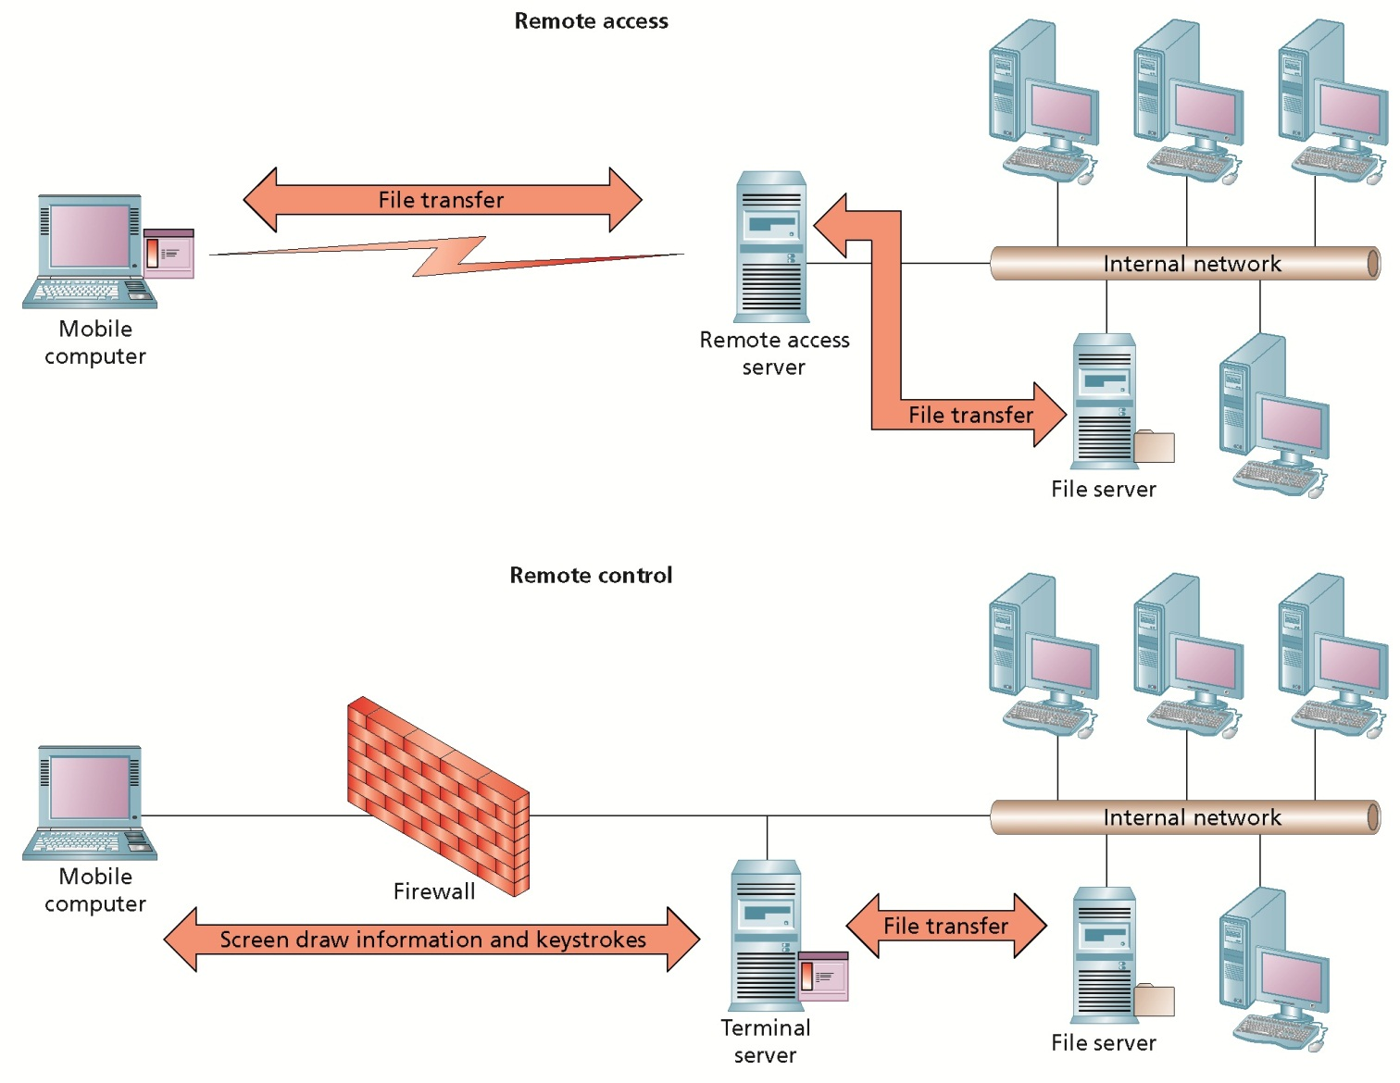
Remote Access and Remote Control Overview (cont'd.)

Slide 6
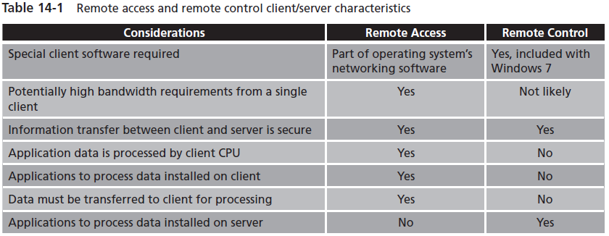
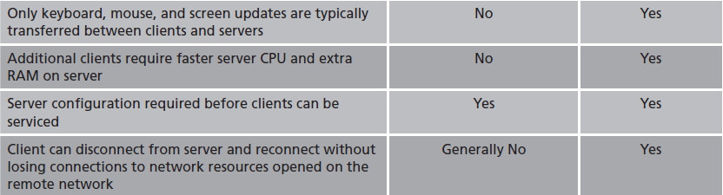
Remote Access and Remote Control Overview (cont'd.)

Slide 7
Remote Access Dial-Up Connectivity
Remote clients connect to a remote access server through a Wide Area Network (WAN)
Windows 7 supports both analog and ISDN dial-up connections

Slide 8
Dial-Up Protocols
Windows 7 supports the industry standard Point-to-Point Protocol (PPP)
  For end-to-end communications between a remote client and remote server using dial-up connections
PPP has the ability to carry different protocols within PPP data packets
  Including TCP/IP data

Slide 9
Analog Dial-Up Connections
Public Switched Telephone Network (PSTN)
  Also called Plain Old Telephone System (POTS)
  Designed to carry human voices from one phone to another as an analog signal
Analog dial-up modem
  Converts digital information into analog form
    Compatible with delivery over the PSTN
Main disadvantage of analog dial-up is that it is slow
  Transferring below 100,000 bits of data per second

Slide 10
Analog Dial-Up Connections (cont'd.)
Remote access server must have one modem per dial-up client that is connected at the same time
  Each modem requires a separate phone line
Steps for configuring dial-up networking:
  Install an analog dial-up modem in the client computer
  Configure dialing rules for phone and modem options
  Create a connection to a remote access server
  Review dial-up connection properties
  Configure optional advanced settings

Slide 11
Analog Dial-Up Connections (cont'd.)
Install an Analog Dial-Up Modem
  Analog dial-up modems must be installed and their supporting hardware driver must be fully functional
    Before any other configuration steps are performed
Configure Dialing Rules for Phone and Modem Options
  Windows 7 can control the dialing process
    Based on where a user and computer are physically located by using dialing profiles
  Define at least one location-based dialing profile

Slide 12
Analog Dial-Up Connections (cont'd.)
Configure Dialing Rules for Phone and Modem Options (cont'd.)
  Dialing rules are defined through the Phone and Modem Options Control Panel applet
Create a Connection to a Remote Access Server
  Connection requires the phone number and usually a username and password
  Activate the Set up a Connection or Network wizard
  Must know remote access server’s dialing information

Slide 13
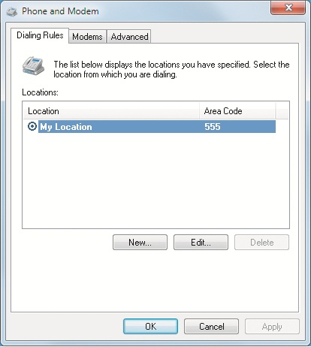
Analog Dial-Up Connections (cont'd.)

Slide 14
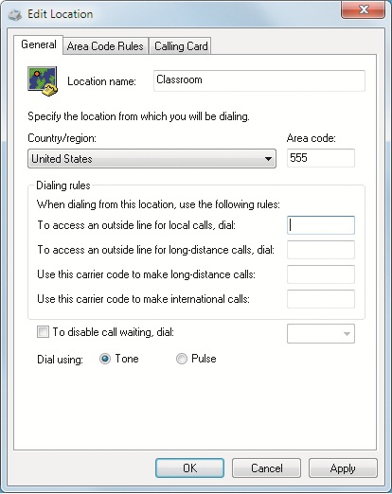
Analog Dial-Up Connections (cont'd.)

Slide 15
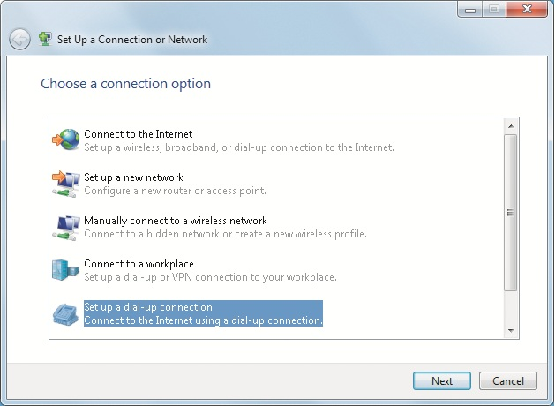
Analog Dial-Up Connections (cont'd.)

Slide 16
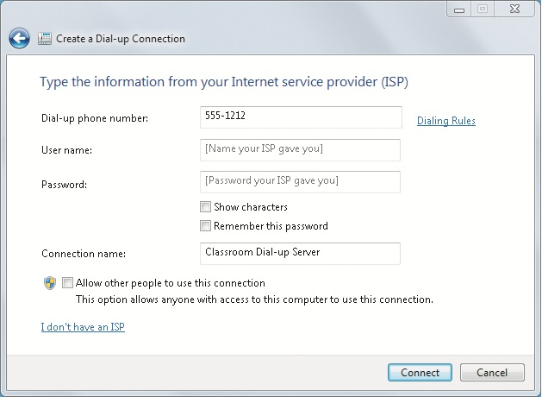
Analog Dial-Up Connections (cont'd.)

Slide 17
Analog Dial-Up Connections (cont'd.)
Review Dial-Up Connection Properties
  Access Network and Sharing Center from Control Panel
    Follow the link to Change adapter settings
  Open the Network Connections window
    Shows the network connections defined
  Edit the properties of the dial-up connection
    General tab
      Configure devices for the connection and phone numbers used to dial the connection

Slide 18
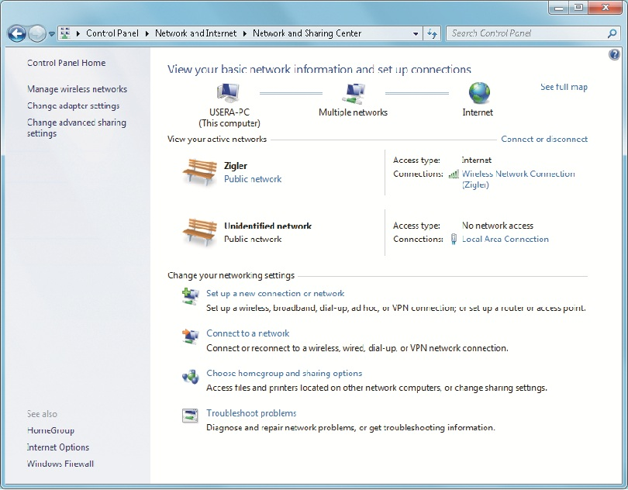
Analog Dial-Up Connections (cont'd.)

Slide 19
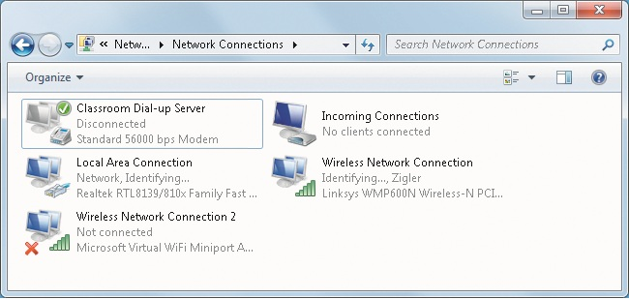
Analog Dial-Up Connections (cont'd.)

Slide 20
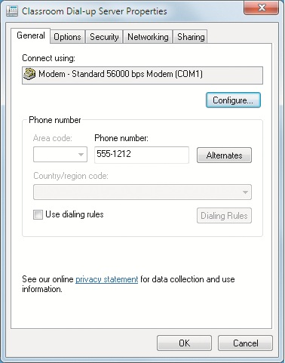
Analog Dial-Up Connections (cont'd.)

Slide 21
Analog Dial-Up Connections (cont'd.)
Review Dial-Up Connection Properties (cont'd.)
  Edit the properties of the dial-up connection (cont'd.)
    Options tab
      Changes the behavior of the dial-up connection while it is connecting
    Security tab
      Controls the behavior of the dial-up connection while it is connecting

Slide 22
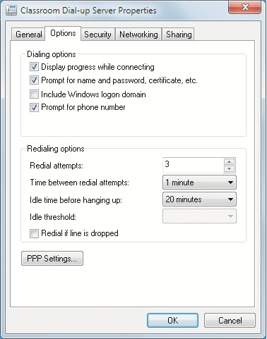
Analog Dial-Up Connections (cont'd.)

Slide 23
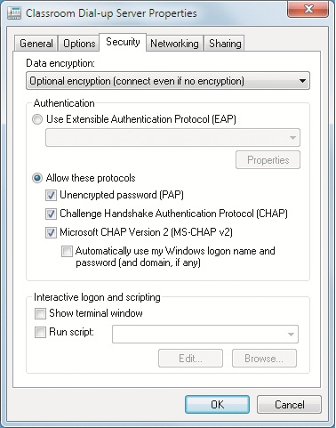
Analog Dial-Up Connections (cont'd.)

Slide 24
Analog Dial-Up Connections (cont'd.)
Review Dial-Up Connection Properties (cont'd.)
  Edit the properties of the dial-up connection (cont'd.)
    Security tab
      If Extensible Authentication Protocol (EAP) is enabled, then EAP-MSCHAP v2 is the default logon security method
      Password Authentication Protocol (PAP) transfers user credentials in plain text and is not a secure authentication protocol
    Networking tab
      Shows the network communication components used by the connection

Slide 25
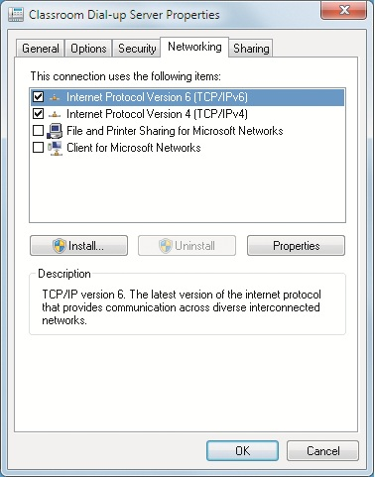
Analog Dial-Up Connections (cont'd.)

Slide 26
Analog Dial-Up Connections (cont'd.)
Configure Optional Advanced Settings
  Remote Access Preferences
    Autodial
      Defines which connection is automatically triggered if the computer tries to connect to a network
    Callback
      Allows the user to configure how their client requests or responds to offers of a callback
    Diagnostics
      Enable logging for a dial-up connection

Slide 27
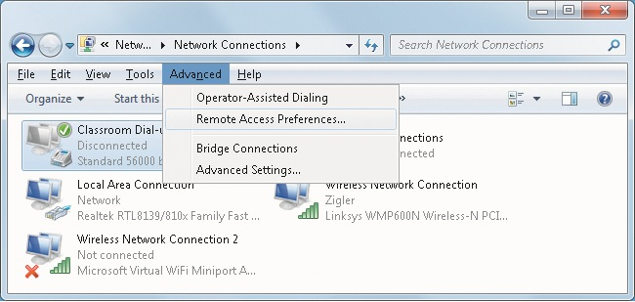
Analog Dial-Up Connections (cont'd.)

Slide 28
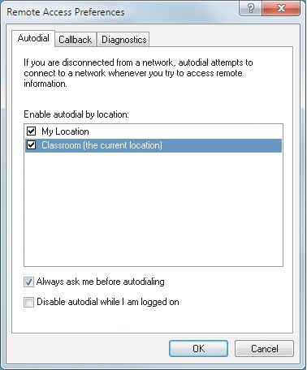
Analog Dial-Up Connections (cont'd.)

Slide 29
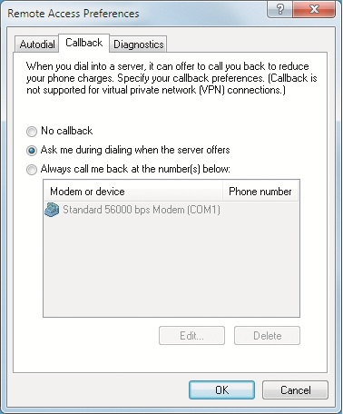
Analog Dial-Up Connections (cont'd.)

Slide 30
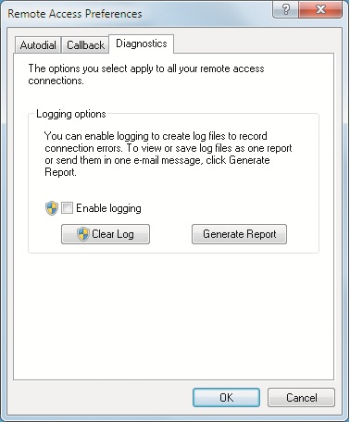
Analog Dial-Up Connections (cont'd.)

Slide 31
Analog Dial-Up Connections (cont'd.)
Configure Optional Advanced Settings (cont'd.)
  Operator-Assisted Dialing
    When enabled, any network connection that is activated will first display a connection window
    Gives the user time to contact the operator and prepare the phone connection
  Interactive Logon and Scripting
    “Show terminal window” option opens a terminal window when the connection is being established
    “Run script” option is used to define a script that runs as part of the connection process

Slide 32
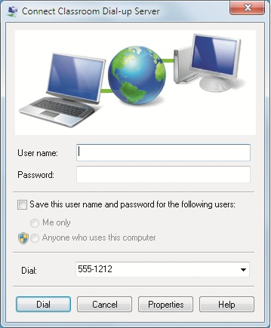
Analog Dial-Up Connections (cont'd.)

Slide 33
Remote Access VPN Connectivity
Data transmitted over the public network can be recorded or modified
  By individuals with criminal or mischievous intent
Secure point-to-point connection can be created using VPN technology
VPN technology
  Similar to remote access in that a server and client form the two endpoints of a connection
  Different from a remote access connection in that it protects the data transferred between its endpoints

Slide 34
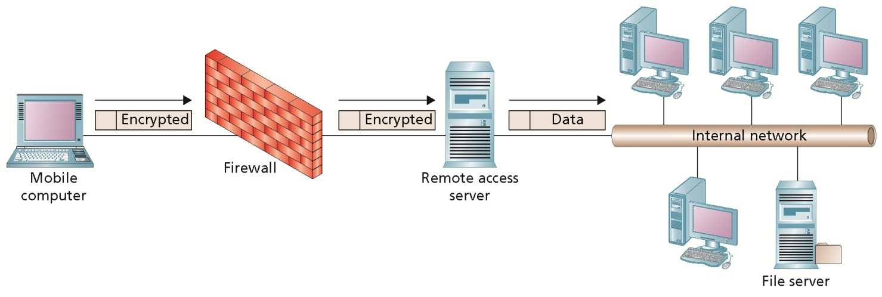
Remote Access VPN Connectivity (cont'd.)

Slide 35
VPN Protocols
Communication protocols
  Called tunneling protocols
  Manage virtual private link and encrypt its data
Point-to-Point Tunneling Protocol (PPTP)
  Allows IP-based networks to deliver PPP packets by encapsulating them in IP packets
  IP packets can be routed through public networks
  PPTP can be used with TCP/IPv4 and TCP/IPv6 networks

Slide 36
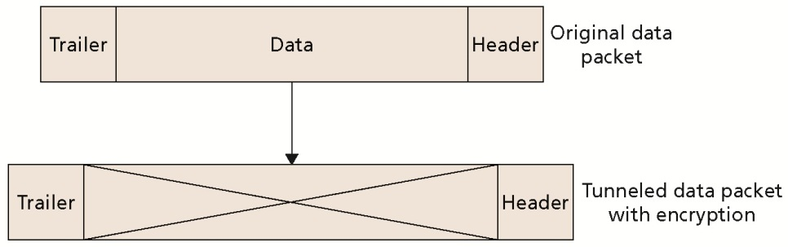
VPN Protocols (cont'd.)

Slide 37
VPN Protocols (cont'd.)
Layer 2 Tunneling Protocol (L2TP)
  Encapsulates PPP packets to be sent over IP network connections
  Started as a combination of PPTP and Layer 2 Forwarding (L2F) tunneling protocols
  IPSec provides encryption for L2TP connections
  L2TP can be used with TCP/IPv4 and TCP/IPv6 networks
Secure Socket Tunneling Protocol (SSTP)
  Allows IP-based networks to deliver traffic through firewalls that would otherwise block PPTP and L2TP

Slide 38
VPN Protocols (cont'd.)
Internet Key Exchange v2 Tunneling Protocol (IKEv2)
  Standardizes the use of the IPSec protocol to establish a Security Association (SA) between the VPN client and server
  IKEv2 Mobility and Multihoming Protocol (MOBIKE)
    Allows a VPN client to lose its network connection and still reconnect to its original SA once network connectivity is restored

Slide 39
Creating a VPN Connection
Before creating a VPN client connection, consider:
  VPN server must identify if it is using a IKEv2, SSTP, PPTP or L2TP connection
  Encryption and authentication methods used by the VPN client and server must be compatible
  IP connection path must exist between the VPN server and the VPN client
  VPN client must know the address of the VPN server on the IP network
More than one VPN connection can be defined

Slide 40
Creating a VPN Connection (cont'd.)
Define a VPN connection
  Activate the “Set up a connection or network” wizard
Set up a VPN connection window’s options
  Internet address
  Destination name
  Use a smart card
  Allow other people to use this connection
  Don’t connect now; just set it up so I can connect later
Enter user’s identity

Slide 41
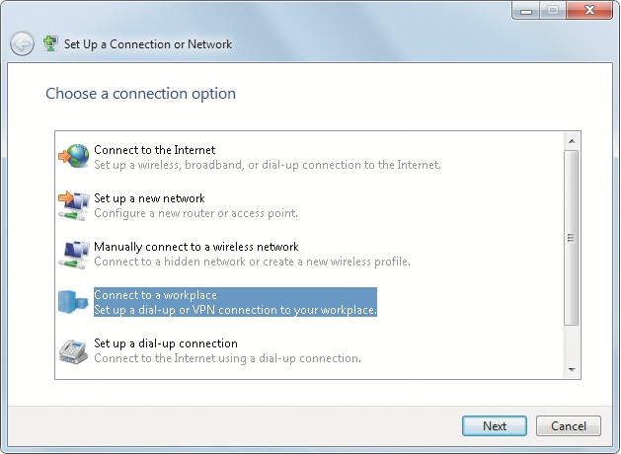
Creating a VPN Connection (cont'd.)

Slide 42
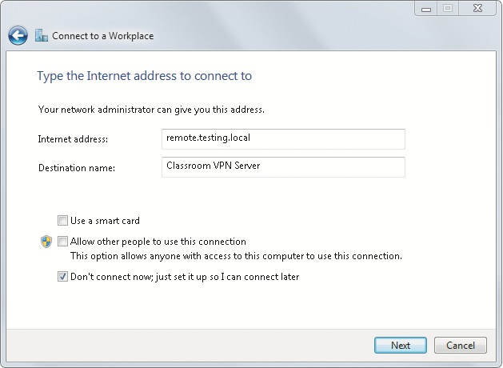
Creating a VPN Connection (cont'd.)

Slide 43
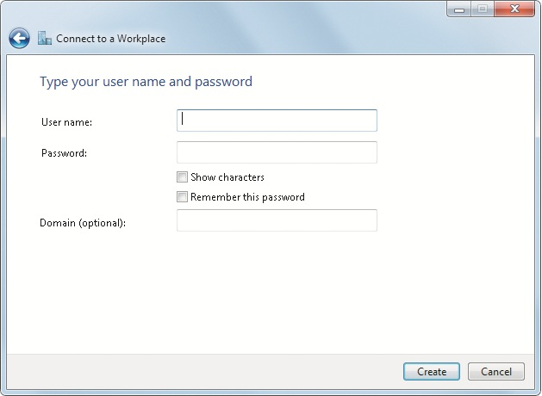
Creating a VPN Connection (cont'd.)

Slide 44
Configuring a VPN Connection
Additional settings are available to refine the VPN connection’s properties
Use the Network Connections window
VPN connection’s properties
  General tab is used to configure
    Host name or IP address
    Dial another connection first
    Dial-up connection list
  Security tab has the option of specifying the type of VPN tunneling protocol to use for a connection

Slide 45
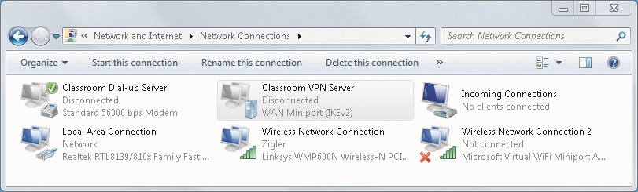
Configuring a VPN Connection (cont'd.)

Slide 46
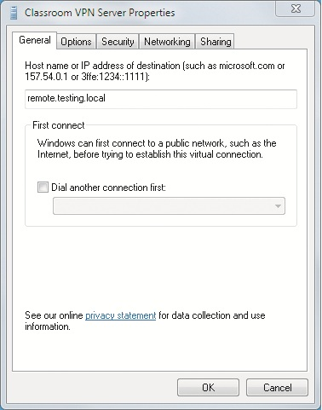
Configuring a VPN Connection (cont'd.)

Slide 47
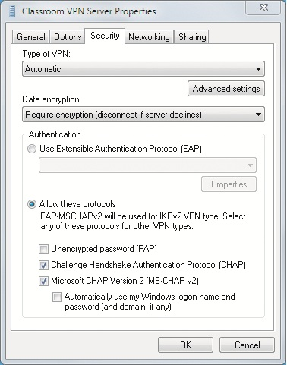
Configuring a VPN Connection (cont'd.)

Slide 48
Configuring a VPN Connection (cont'd.)
VPN connection’s properties (cont'd.)
  Networking tab identifies the network communication components
  Sharing tab allows the VPN connection to be shared and controlled
    By other users on the computer’s local network

Slide 49
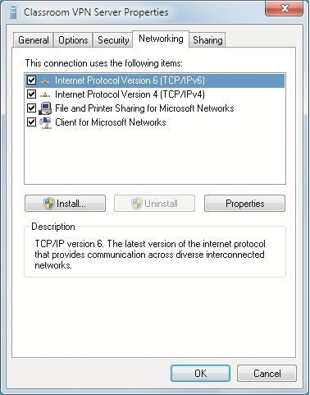
Configuring a VPN Connection (cont'd.)

Slide 50
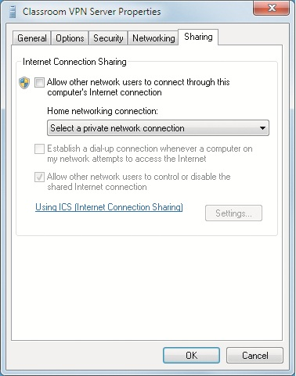
Configuring a VPN Connection (cont'd.)

Slide 51
DirectAccess
Windows 7 can work together with Windows Server 2008 R2
Users are provided with the same experience working remotely as they would have working in the office
DirectAccess activates itself before the user logs on the computer
DirectAccess can limit which applications and resources the user is allowed to access

Slide 52
Remote Desktop
Remote Desktop Protocol (RDP)
  Designed to carry remote control session data efficiently and securely
    Between the client and server involved in a remote control session
Remote Desktop client
  Software that is used to remotely control a Windows 7 computer
  Available as a stand-alone client application and as a Web client

Slide 53
Stand-Alone Remote Desktop Client
Most commonly used version of the client
New version designed specifically for Windows 7 and Windows Server 2008 R2
Improvements include:
  Support for Network Access Protection client updates
  Bidirectional audio
  Remote application task scheduler can automatically start remote applications
  Ability to support up to 16 multiple monitors
  Support for Aero glass

Slide 54
Stand-Alone Remote Desktop Client (cont'd.)
General Settings
  Found in the Start menu as a menu item in the Accessories subfolder
  Several optional settings are available
Display Settings
  Configure the screen settings to set the local experience during the remote control session
  Increase the resolution and color settings with caution
    Amount of data increases

Slide 55
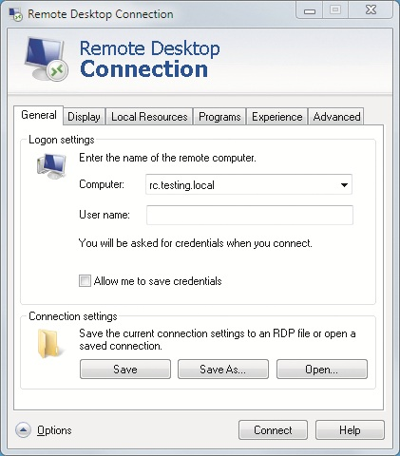
Stand-Alone Remote Desktop Client (cont'd.)

Slide 56
Stand-Alone Remote Desktop Client (cont'd.)
Local Resource Settings
  Allows the remote user to define which local resources are available inside the remote control session
Program Settings
  Defines one specific program that should run each time the connection is established
Experience Settings
  Used to adjust factors that impact the remote control session experience

Slide 57
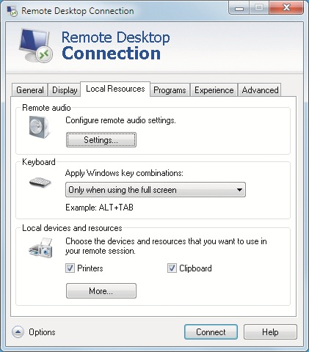
Stand-Alone Remote Desktop Client (cont'd.)

Slide 58
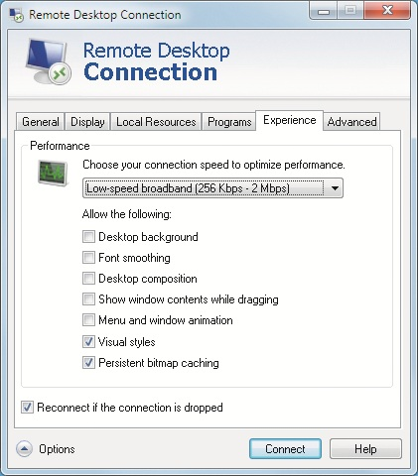
Stand-Alone Remote Desktop Client (cont'd.)

Slide 59
Stand-Alone Remote Desktop Client (cont'd.)
Advanced Settings
  Includes a section for server authentication
  Feature is only supported if the remote client and the remotely controlled computer use Network Level Authentication
  Network Level Authentication
    Security protocol used by clients and servers to prove their identity before data connection is set
Command-Line Options
  Available only by running the remote desktop client program MSTSC.EXE directly from the command line

Slide 60
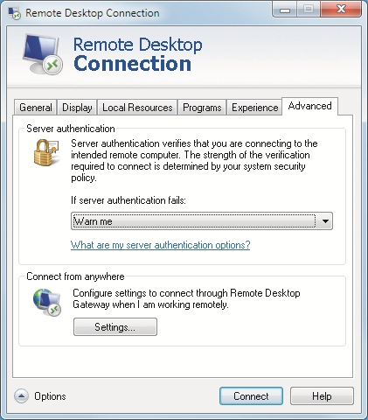
Stand-Alone Remote Desktop Client (cont'd.)

Slide 61
RemoteApp and Remote Desktop Web Access
RemoteApp
  Allows the publishing of remote applications
Remote Desktop Web Access
  Presents RemoteApps and remote connections to the user in one Web-based resource

Slide 62
Remote Assistance
Allows a user to send an invitation to a remote user using instant messaging or e-mail
  Invites them to remotely connect to the local computer
They can establish a secure remote connection to view what is happening on the desktop
Local user can electronically chat with the person providing remote assistance
Remote user can optionally be granted complete keyboard and mouse control
  During the remote assistance session

Slide 63
Remote Assistance (cont'd.)
Windows Remote Assistance wizard
  Accessed by clicking the Windows Remote Assistance link in Help and Support
Can give a remote user the ability to access sensitive information and settings on a computer
Invitation to use remote assistance is password protected
  Unique password selected for that specific invitation

Slide 64
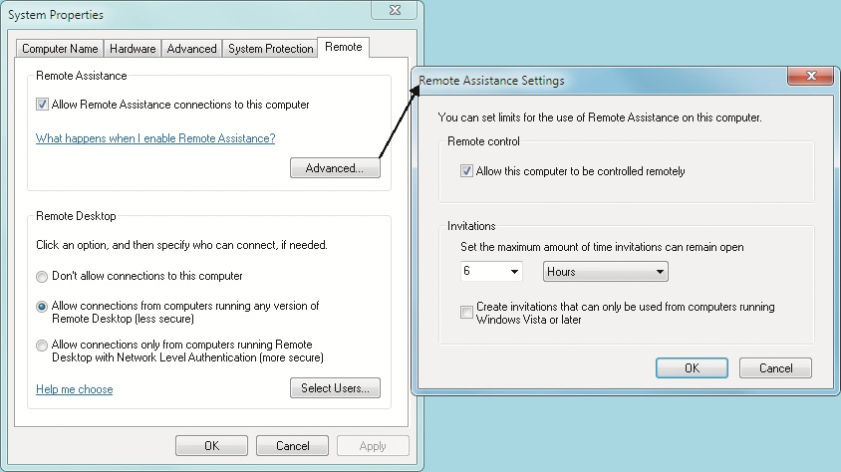
Remote Assistance (cont'd.)

Slide 65
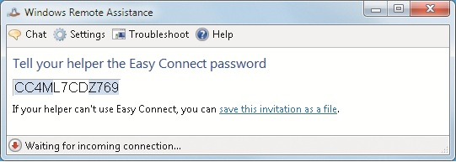
Remote Assistance (cont'd.)
Remote client can be running Windows XP or Windows Server 2003 at a minimum
Remote assistance control window has button controls to activate:
  Chat window, file transfer, and control desktop sharing

Slide 66
BranchCache
BranchCache
  Allows remote office users to speed up their access to information
Requires that clients interact with servers running Windows Server 2008 R2 as a minimum
BranchCache can operate in two modes:
  Hosted Cache mode
  Distributed Cache mode
Servers at head office track the content of cached data using identifiers and metadata

Slide 67
Sync Center
When a computer is portable, one of the problems is making sure a user still has access to his/her data
Windows 7 provides Sync Center as a central control mechanism
Sync Center window lists all of the data sources that need to be cached on the local computer
Resource must be compatible with the Sync Center to be available as an item to track and synchronize

Slide 68
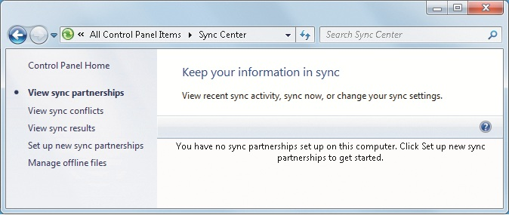
Sync Center (cont'd.)

Slide 69
Mobility Center
Windows 7 places controls for mobile computer features in one single window
Typical controls found in the Mobility Center include:
  Battery status and power management
  Wireless network configuration
  Display configuration
  Synchronization settings
  Presentation settings

Slide 70
Summary
Windows 7 supports both remote access and remote control
Dial-up remote access can be done with a modem and regular phone line or ISDN
VPN connections allow you to securely access data over the Internet
DirectAccess allows Windows 7 Enterprise clients to connect to corporate intranet resource without a VPN while they are outside the corporate network
Remote control client functionality has been enhanced to support server authentication

Slide 71
Summary (cont'd.)
Remote Assistance is a software tool to ask trusted users to connect over the network and provide help
BranchCache helps speed up performance for users in remote branch offices that do not have the same access to corporate data as other users in the main office
Sync Center allows mobile users to quickly and easily synchronize network content on the mobile computer
Mobility Center is a feature available only on Mobile computer

